Slide 1
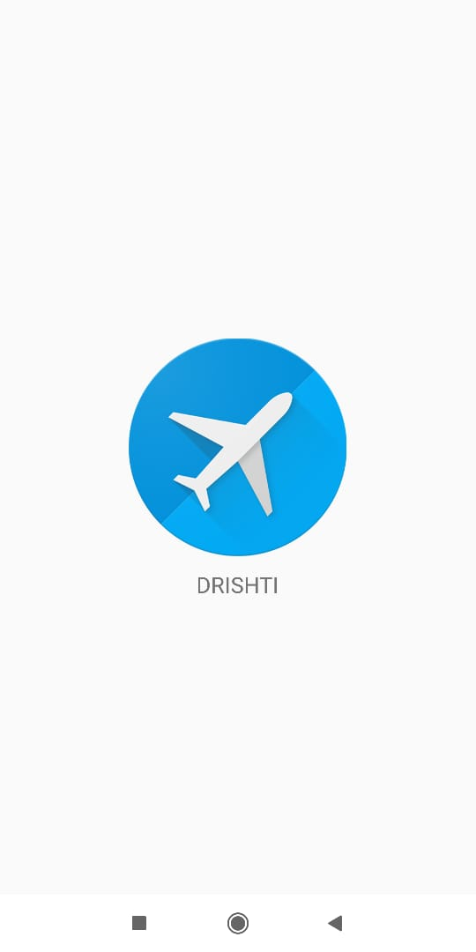
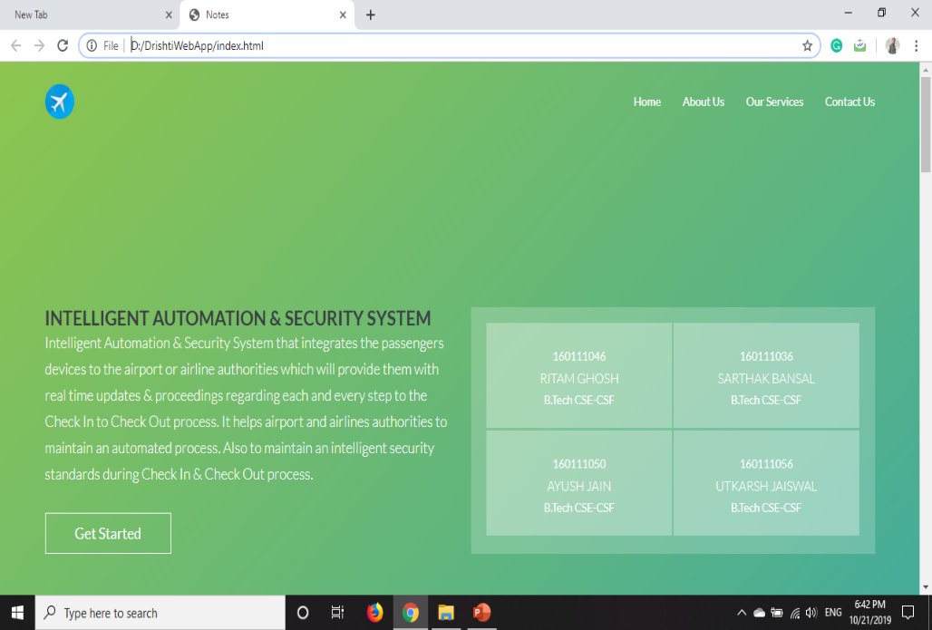
DRISHTI
Intelligent Automation & Security System
For
Airport Facility
RITAM GHOSH (160111046) SARTHAK BANSAL (160111036)
AYUSH JAIN (160111050) UTTKARSH JAISWAL (160111059)

Slide 2
Agenda
Objective & Problem Statement
01
Functionalities
02
Hardware & Software Requirements
03
Conclusion
04

Slide 3
OBJECTIVE
Agenda Style
Intelligent Automation & Security System
To design and develop a Intelligent Automation & Security System that integrates the passengers devices to the airport or airline authorities which will provide them with real time updates & proceedings regarding each and every step to the Check In to Check Out process. It helps airport and airlines authorities to maintain an automated process. And also to maintain an intelligent security standards during Check In & Check Out process.
01. Objective

Slide 4
Problem Statement
Agenda Style
Intelligent Automation & Security System
Every year millions of passengers travel around the world through airways.
They all have to go through long and tiring duration of security checks, check in & check out, boarding & logging process.
In India for domestic flights usually a passenger has to arrive 2-3 hours before the flight time and for international flights the time is even more.
Many of the travelers those who are new, doesn’t have any clue how the things works and makes situations very complex and its similar for other semi or regular travelers.
Also the airport or airlines authorities have to manage and focus on wide range of ongoing process, its also became very hectic & complex for them to manage and continue it.
During security check and other validations process it became difficult for both passengers and authorities to maintain & its also time consuming.
01. Problem Statement

Slide 5
Future Scope
Agenda Style
Intelligent Automation & Security System
It would be useful & helpful to the customers and service providers of airports and airlines facilities around the world.
It will make security check & validation simpler, stable, structured, more efficient & faster.
It will make check in & check out process faster & simpler in nature.
It would provide self automation, which require less man force & lesser resources, capital & time.
It can also be integrated in other public sectors with change in parameters & specifications.
01. Future Scope

Slide 6
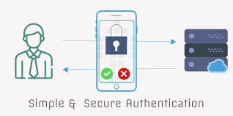
02. Functionalities
Every passenger will have our application installed on his smartphone / tablet .
As the passenger will book a ticket his PNR number will be generated along with all the details he/she will need to enter the airport.
The passenger will have to log in to our application by using his PNR number to get all the details that will be required for further process.
Then the application will provide all the details about the flight ,its arrival time , departure time, luggage belt etc.

Slide 7
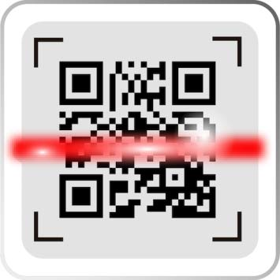
When the passenger arrive at the airport he will have to use the application on his phone to scan the QR code that will be present on the airport gate on a digital screen.
Then that digital screen will show all his personal details .
The digital machine will have a face detector camera/fingerprint scanner which will detect the persons face or fingerprint and match it to the persons ‘Aadhar card’.

Slide 8

Now that person gets the authority to enter inside the airport.
After entering in the airport he will get a welcome message and pop up notifications about the flight and the airport. It will also send a digital boarding pass to the persons phone.
It will direct him to go to the baggage drop belt where he will leave his baggage after sticking a GPS enabled tag on it by which he/she can track his luggage from his phone.

Slide 9

Now the person will pass through manual security check and scanners for any illegal item detection.
After this the person is all free to relax and the person is all ready to onboard the plane.
If in any case the flight gets delayed the application will inform the passenger about the delay and will also provide the details where he can get complimentary food packets from the airlines.

Slide 10

The application will also give a virtual tour of the airport/map of the airport which will guide him to get the best services at the airport.
Thus the passenger will not suffer as he will save a lot of time and would not have to arrive much early.
On the other hand this will help airlines to communicate with their passengers.

Slide 11


Slide 12
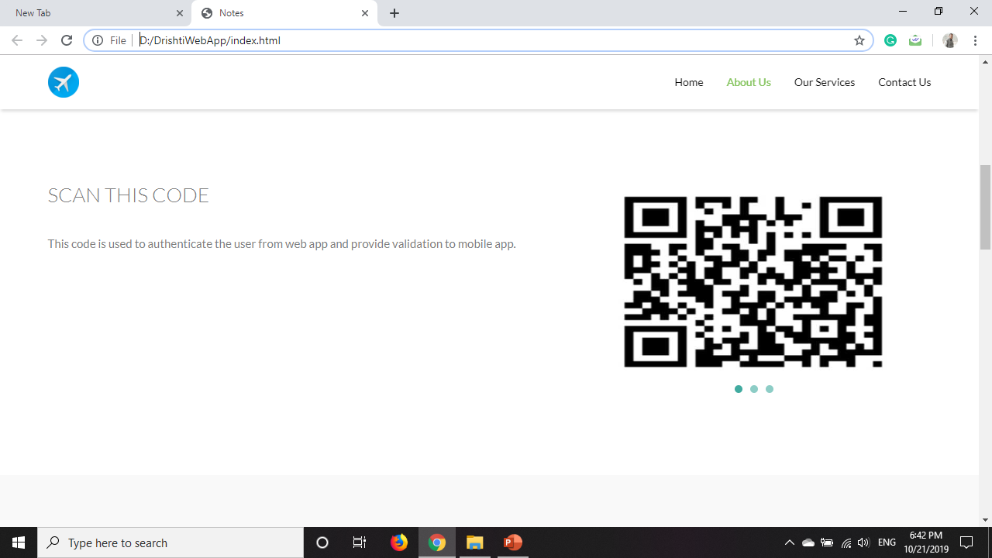

Slide 13
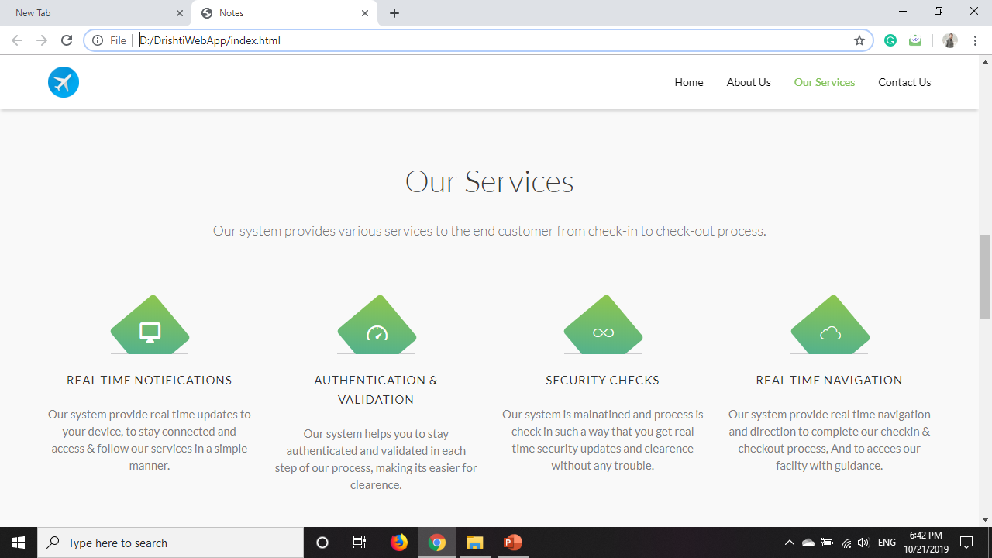

Slide 14
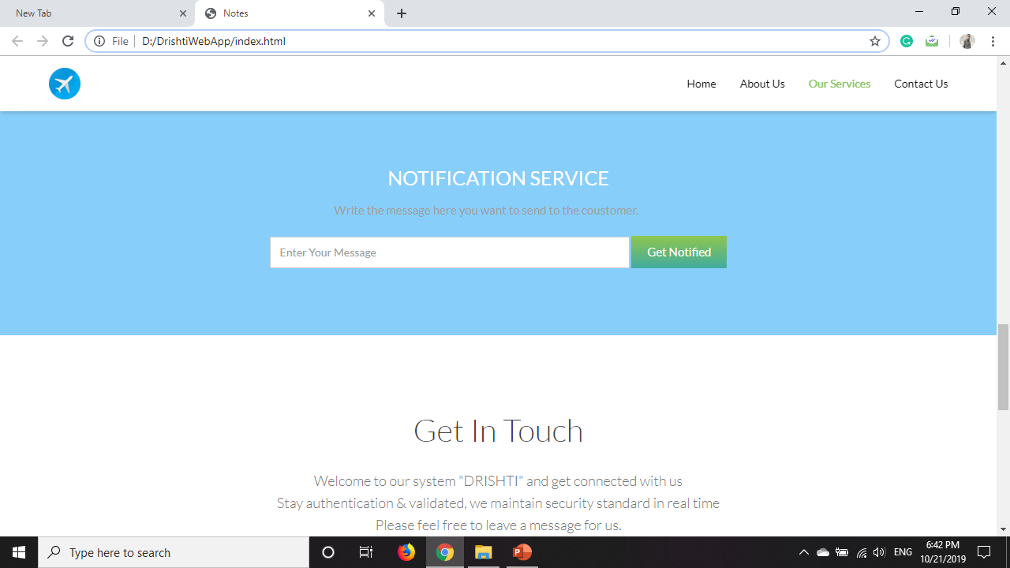

Slide 15
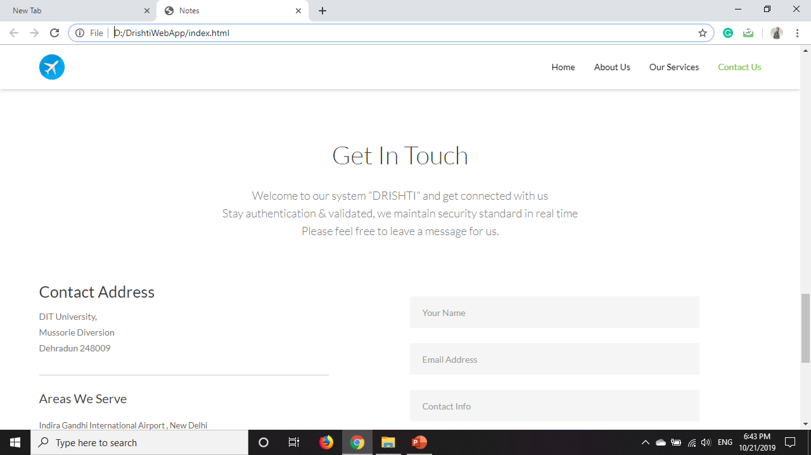

Slide 16
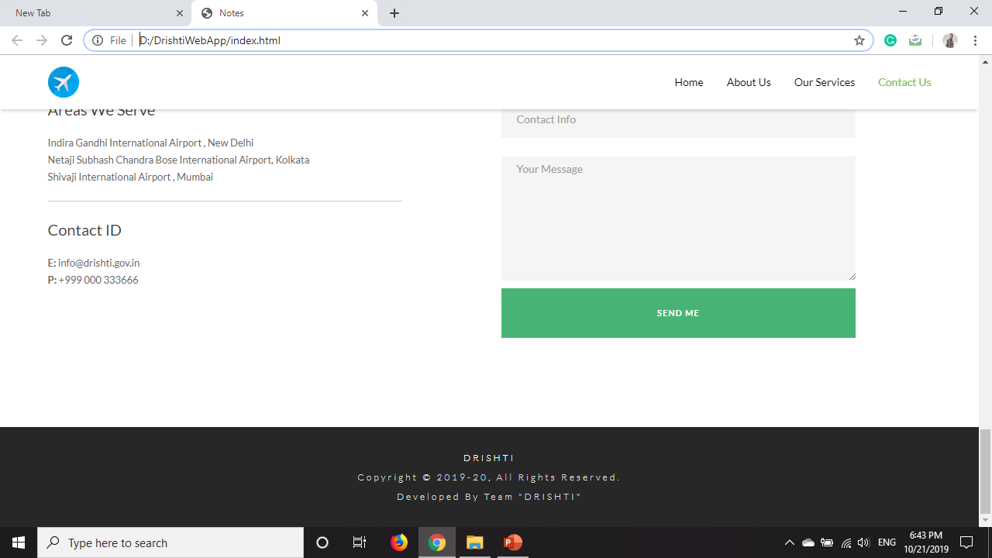

Slide 18
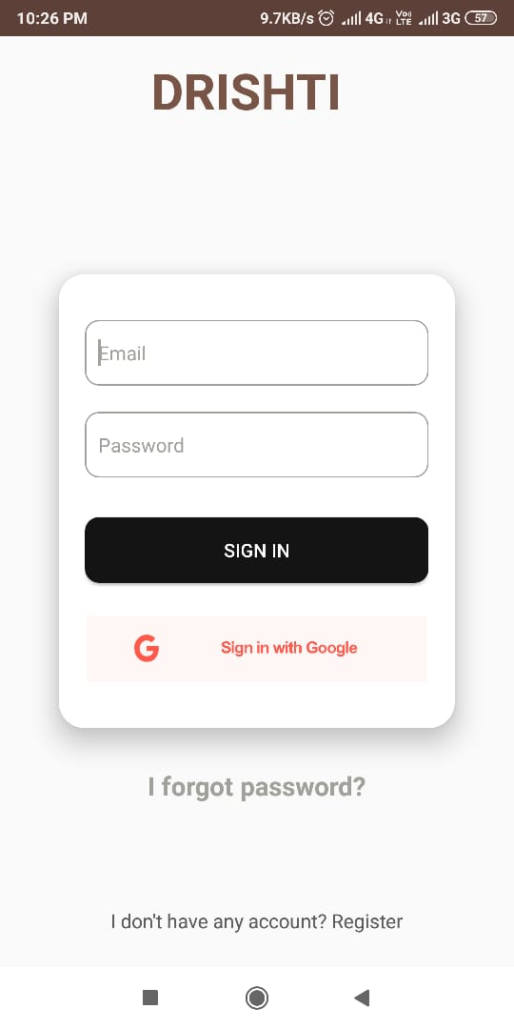
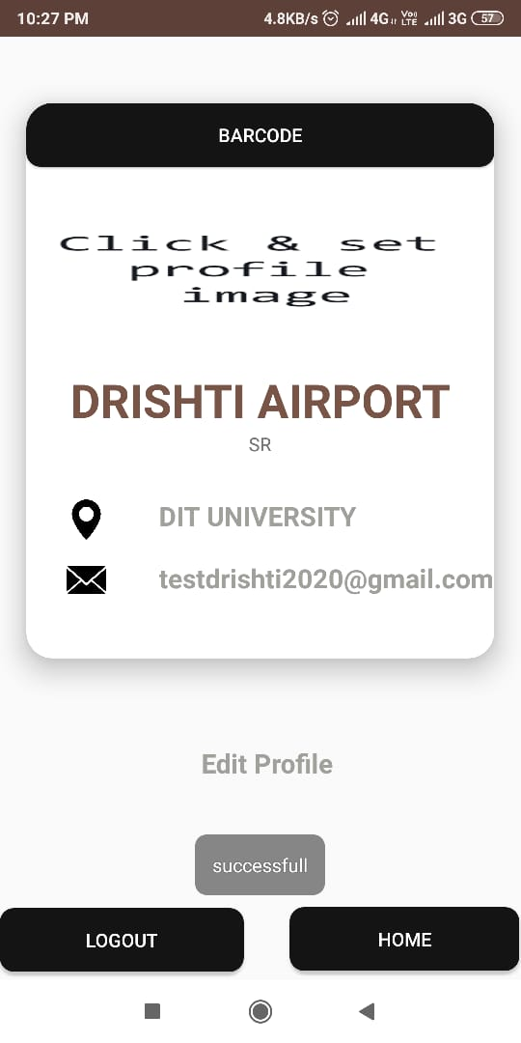

Slide 19
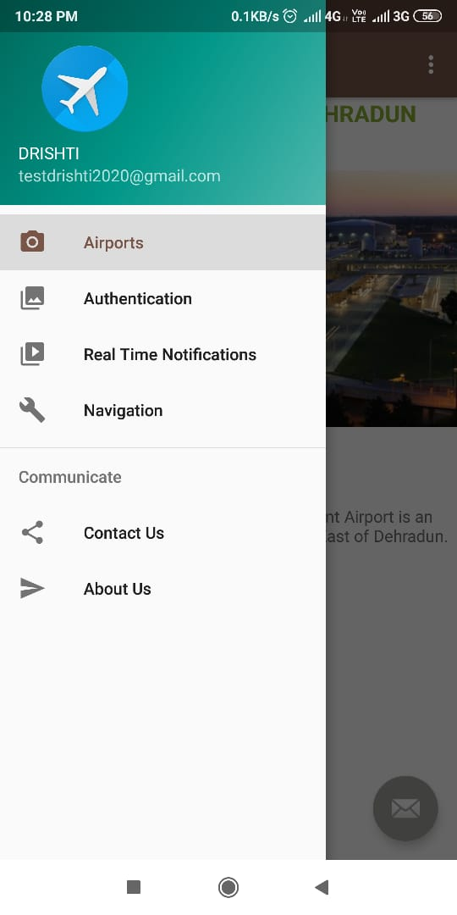
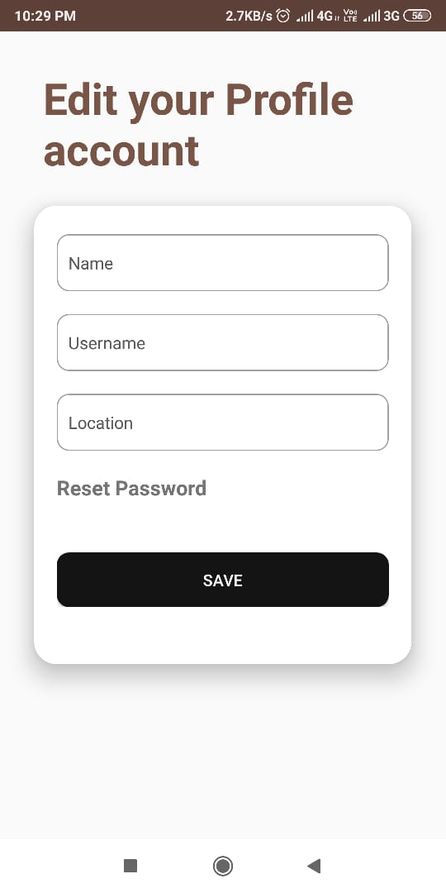

Slide 20
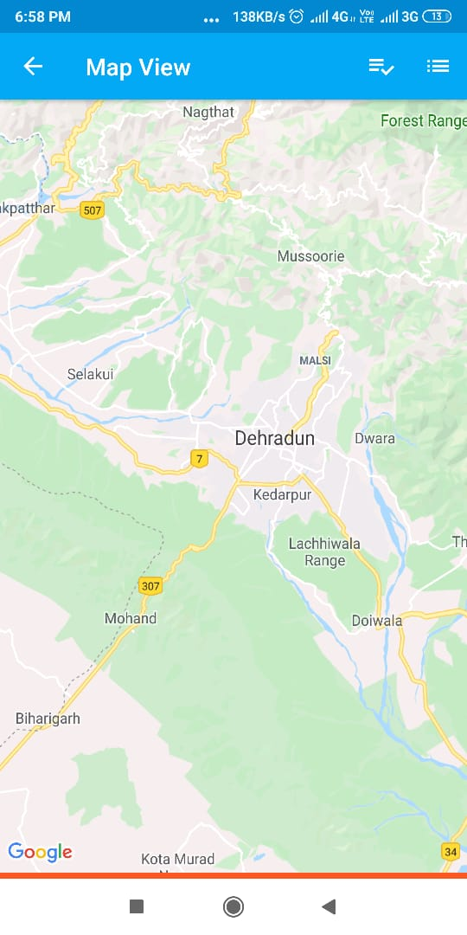
VIRTUAL MAP

Slide 21
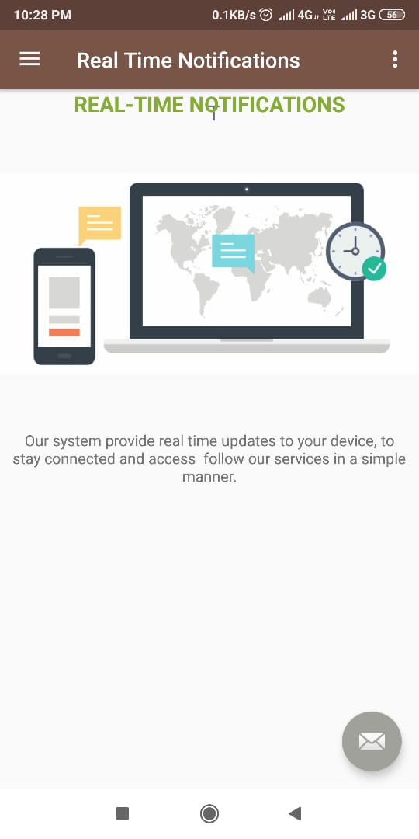
NOTIFICATION AND PNR ALLOCATION

Slide 22
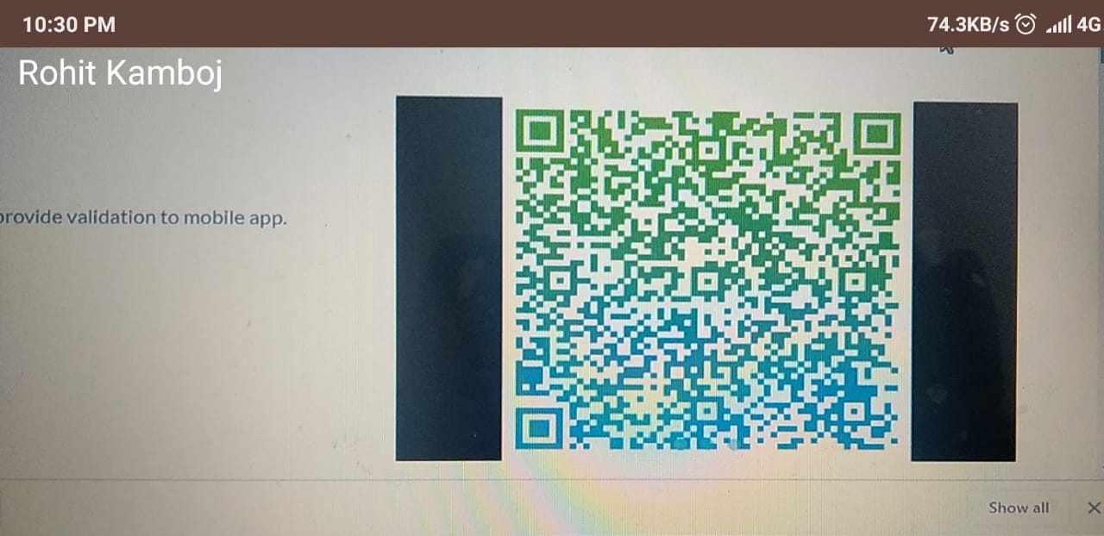
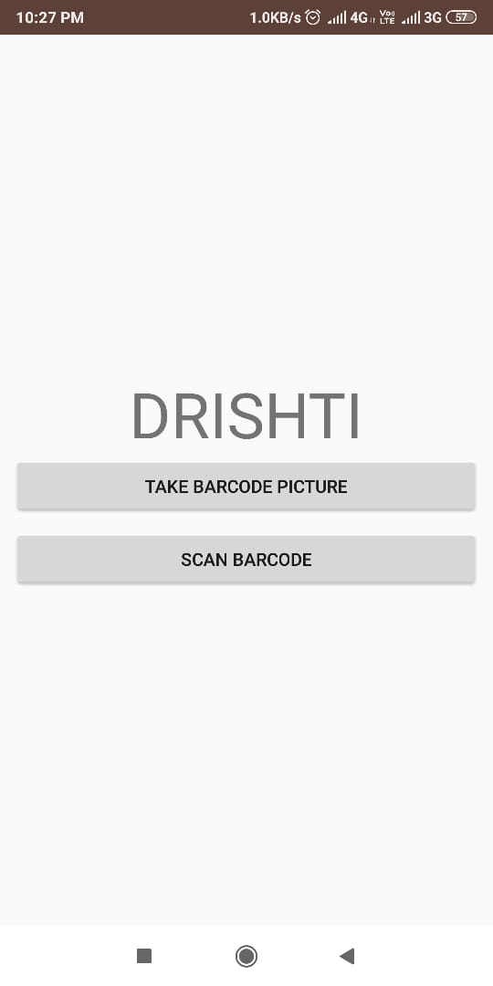
BARCODE VERIFICATION

Slide 23
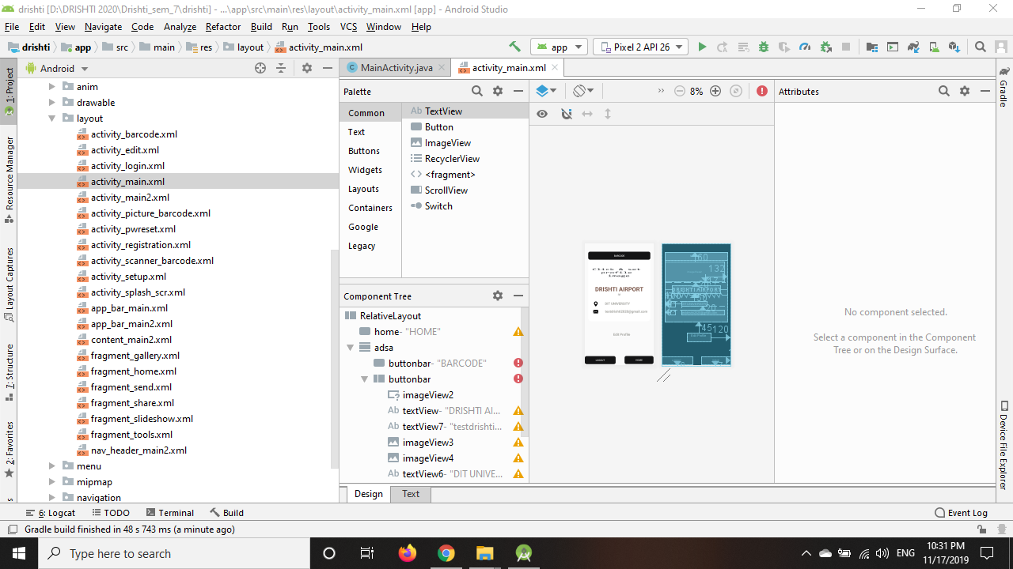
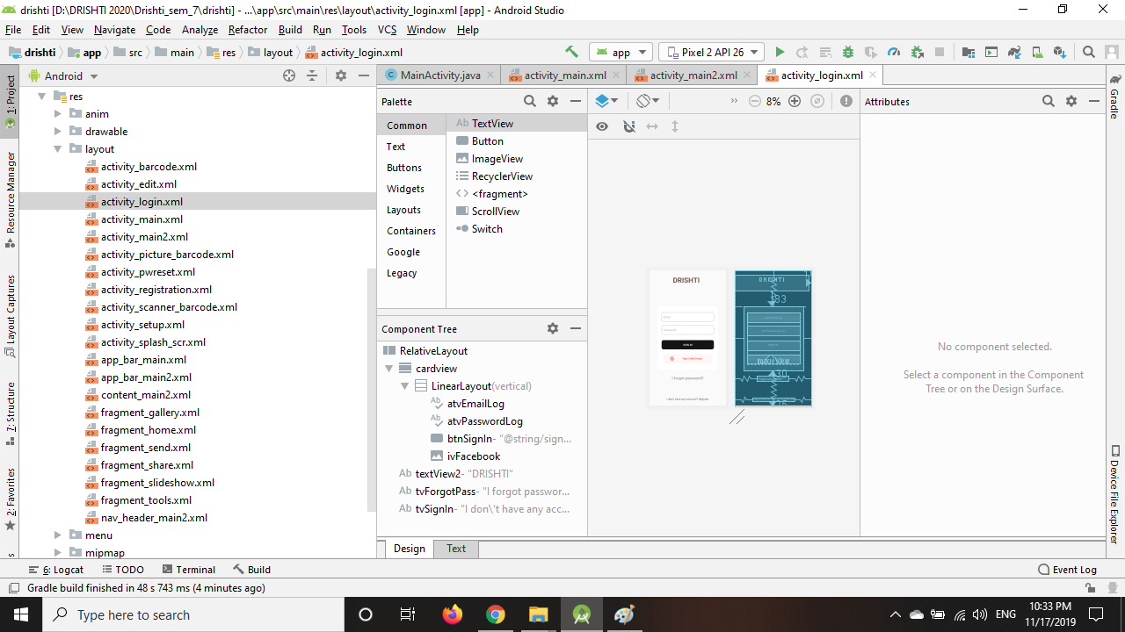

Slide 24
HARDWARE REQUIREMENT
Agenda Style
Intelligent Automation & Security System
RFID NFC TAG
FINGERPRINT SCANNER
INTEL I5 AND ABOVE
2.G GHZ AND ABOVE
8 GB RAM AND ABOVE
2 GB VR RAM AND ABOVE
CAMERA
MOBILE DEVICE (KITKAT and above)
BARCODE SCANNER
03. Problem Statement

Slide 25
SOFTWARE REQUIREMENT
Agenda Style
Intelligent Automation & Security System
ANDROID KIT-KAT AND ABOVE
WINDOWS 10 AND ABOVE
ANDROID STUDIO
WEB BROWSER
ANACONDA
PYTHON
JAVA
FIREBASE
VM Ware
Cloud Services
PHP & JS
HTML, CSS, Bootstrap
03. Problem Statement

Slide 26
Features
Agenda Style
Intelligent Automation & Security System
Secure
Simple Design
Stable
Time Saver
Structured
Automated
Navigation
Authentication
Notifications
Finger Print Recognition
Face & Image Recognition
RFID Detection
Multi factor verification
04. Problem Statement

Slide 27
Conclusion
Agenda Style
Intelligent Automation & Security System
Our system will fully provide automate airport and airlines system and also provide intelligent security system.
It will be simpler for customers and service providers to maintain and manage and clear all the processes in ease.
04. Conclusion

Slide 28
Thank you !!!

